Slide 1




IcedTea: Efficient and Responsive Time-Travel Debugging in Dataflow Systems
Chen Li
Joint work with Shengquan Ni, Yicong Huang, Zuozhi Wang

Slide 2
IcedTea: Overview
Programming languages: debugging
Programming languages: time-travel debugging
Dataflows: debugging
Dataflows: time-travel debugging (IcedTea)

Slide 3
Example dataflow: Fraud Detection
Source
(U)
Feature Extractor
(FE)
Fraud Detector
(FD)
Fraud Filter
(FF)
Sink
(S)
Streaming
read from
payment table.
Extracts features. Maintain the highest amount paid for each user.
ML-based fraud detection using the extracted features.
Keeps a blacklist.
Filter out fraud payments.
Record the number of frauds.
Real-time report for approved payments.

Slide 4
Example dataflow: Fraud Detection (simpified)
U
FE
FD
FF
S
Top payments:
blacklist:[]
# of frauds: 0

Slide 5
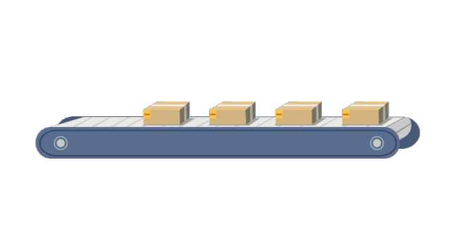
Pipelined Execution
Data Tuples
U
FE
FD
Benefits:
1) Low latency;
2) No materialization of intermediate results

Slide 6
States of operators
U
FE
FD
FF
S
Top payments:
blacklist:[]
# of frauds: 0
Notes:
Operator state can vary based on its application logic.
Statistical State:
Input/output counts
Current throughput
Computational State:
Model weights
Session context

Slide 7

Processing a tuple
(Bob, $20)
U
FE
FD
FF
S
Top payments:
blacklist:[]
# of frauds: 0

Slide 8
Processing a tuple
(Bob, $20, [features…,$20])
U
FE
FD
FF
S
Top payments:{
Bob: $20
}
blacklist:[]
# of frauds: 0

Slide 9
Processing a tuple
(Bob, $20, “Approved”)
U
FE
FD
FF
S
Top payments:{
Bob: $20
}
blacklist:[]
# of frauds: 0

Slide 10
Processing a tuple
(Chris, $50)
(Bob, $20, “Approved”)
U
FE
FD
FF
S
Top payments:{
Bob: $20
}
blacklist:[]
# of frauds: 0

Slide 11
Processing a tuple
(Chris, $50)
(Bob, $20, “Approved”)
U
FE
FD
FF
S
Top payments:{
Bob: $20,
Chris: $50
}
blacklist:[]
# of frauds: 0

Slide 12

Unexpected result
After a while:
U
FE
FD
FF
S
Top payments:{
Bob: $90,
Chris: $50
}
blacklist:[Bob]
# of frauds: 23
All Bob’s payments marked as fraud

Slide 13
A bug caused by a wrong exchange rate
(Bob, $90)
(Bob, ¥5,000,...)
U
FE
FD
FF
S
Top payments:{
Bob: ¥5,000,
Chris: $50
}
blacklist:[]
# of frauds: 0

Slide 14
A bug caused by a wrong exchange rate
(Bob, $90)
(Bob, ¥5,000,“Fraud”)
U
FE
FD
FF
S
Top payments:{
Bob: ¥5,000,
Chris: $50
}
blacklist:[Bob]
# of frauds: 0

Slide 15

A bug caused by a wrong exchange rate
(Bob, $90, “Fraud”)
U
FE
FD
FF
S
Top payments:{
Bob: $90,
Chris: $50
}
blacklist:[Bob]
# of frauds: 1
(Bob, ¥5,000,“Fraud”)

Slide 16
A bug caused by a wrong exchange rate
U
FE
FD
FF
S
Top payments:{
Bob: $90,
Chris: $50
}
blacklist:[Bob]
# of frauds: 2
(Bob, ¥5,000,“Fraud”)
(Bob, $90, “Fraud”)

Slide 17
Limitations of Existing Debuggers
Forward Debugging:
Start
Bug
Cannot debug the past.
Effect observed
Attach debugger, inspect
Time

Slide 18
Limitations of Existing Debuggers
Stop-Restart Debugging:
Start
Restart
Bug
Normal
Effect observed
Normal
Time
Non-deterministic behavior: may cause the bug not to be reproducible.

Slide 19
IcedTea: Time-travel Debugging
Start
Step
Jump
Bug
Effect observed
We allow:
Tuple-based replay of the original execution.
Tuple-based step inspections.
Responsive jump-back.

Slide 20

Time-travel Debugging: Go to the past!

Slide 21
“Happen-before” consistency?
It may not provide useful information
U
FE
FD
FF
S
200th tuple.
178th tuple.
89th tuple.
56th tuple.
33rd tuple.
State after 200th tuple?

Slide 22
New: “tuple-consistency”
Tuple-consistent snapshot w.r.t. a tuple t: every operator’s state right after processing t
t+1
t
U
FE
FD
FF
S
Next Tuple
Start
Snapshot 1
User can jump back to this snapshot later.

Slide 23
Algorithms for computing a tuple-consistent snapshot
Report state
Controller
t+1
t
U
FE
FD
FF
S
Barrier
Notes:
We insert a barrier into the source operator between two consequent tuples.
When each operator processes the barrier, then report their state

Slide 24
Logging for non-deterministics behaviors
Tuple arrival order.
Non-deterministic function calls.

Slide 25
Debugging Primitive: step-over
A tuple goes through the whole workflow
t
U
FE
FD
FF
S
t
t
t
t
t
U
FE
FD
FF
S
It updates the snapshot to a tuple-consistent snapshot after tuple t.

Slide 26
Debugging Primitive: step-into
A tuple goes over one operator
t
U
FE
FD
FF
S
t
U
FE
FD
FF
S
It allows us to inspect the snapshots before and after a tuple is processed by an operator

Slide 27
Debugging Primitive: step-out
One tuple goes to the end of the workflow
U
t
FE
FD
FF
S
t
t
t
t
t
U
FE
FD
FF
S
It changes from the intermediate snapshot to the next tuple-consistent snapshot.

Slide 28
Replay from beginning can take too much time.
(Initial Snapshot)
Checkpointed
Start
Long time
Snapshot
Time

Slide 29
Online Algorithm for Responsive Jumps
User set time limit τ for a jump:
(Initial Snapshot)
Checkpointed
Start
<τ
More Snapshots
Time

Slide 30
Online Algorithm for Responsive Jumps
User set time limit τ for a jump:
(Initial Snapshot)
Checkpointed
Start
Load
<τ
Replay
Time
If next snapshot is close to a checkpoint, we skip taking checkpoints.

Slide 31
Experiments

Slide 32
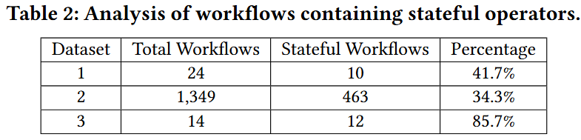
How common are stateful workflows?

Slide 33
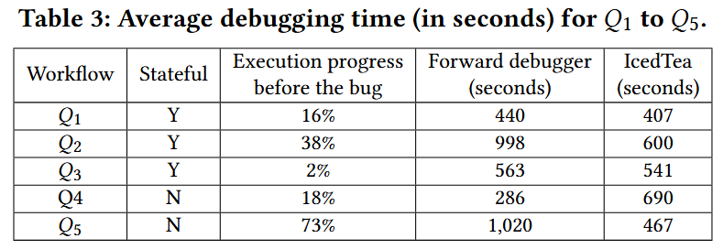
User Study
Notes:
Effectiveness of IcedTea -

Slide 34
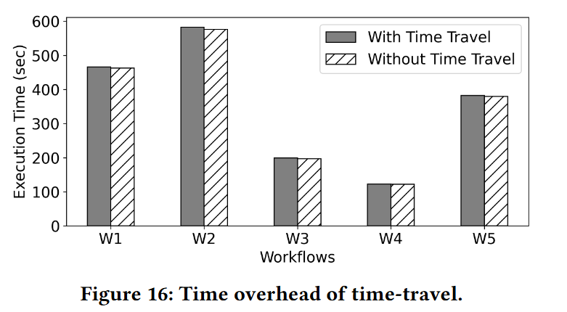
Time overhead

Slide 35
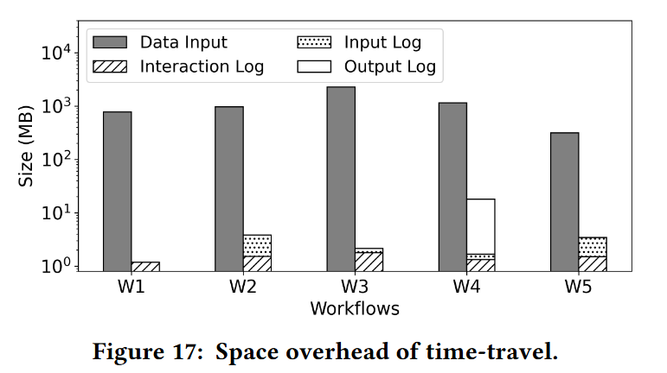
Space overhead

Slide 36
Conclusion: IcedTea for “time-travel debugging”
Formulated a time-travel debugging paradigm in pipelined execution.
Optimized logging to reduce time and space overhead.
Debugging primitives.
Checkpointing algorithm for responsive jumps.
Experimental study

Slide 37
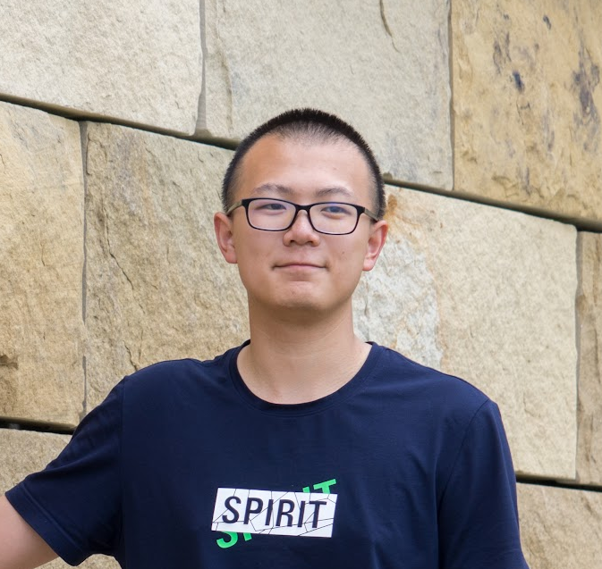



IcedTea: Efficient and Responsive Time-Travel Debugging in Dataflow Systems
Shengquan Ni
Yicong Huang
Zuozhi Wang
Chen Li

Slide 39
Backup slides

Slide 40






Example dataflow: Fraud Detection
Source
(U)
Feature Extractor
(FE)
Fraud Detector
(FD)
Fraud Filter
(FF)
Sink
(S)
Streaming
read from
payment table.
Extracts features. Maintain the highest amount paid for each user.
ML-based fraud detection using the extracted features.
Keeps a blacklist.
Filter out fraud payments.
Record the number of frauds.
Real-time report for approved payments.

Slide 41


Data-Processing Systems
Analytical Workloads
ML Integrations
Event-driven Applications
Parallel + Large-scale
ML-based pattern matching…
Fraud detection…

Slide 42
Effectiveness of IcedTea - User Study
Six participants, split into two groups, debugged five workflows: first three with state-affecting bugs, last two with non-state bugs.
Group A used the forward debugger; Group B used Icedtea with rollback and step-forward.
Measured time to find the tuple which caused the bug.

Slide 43
Extensions
In the paper, we discussed:
How to handle steps with diverge/merge paths in the DAG.
How to handle large operator states.

