Slide 1
Efficient Instant-Fuzzy Search with Proximity Ranking
Inci Cetindil, Jamshid Esmaelnezhad, Taewoo Kim, Chen Li
University of California, Irvine
ICDE 2014

Slide 2


Motivation – Fuzzy Search
Fat finger syndrome!!

Slide 3




Motivation – Fuzzy Search
Data may also have typos!

Slide 4



Motivation – Instant Search
Hi, I am
“Anastasios Kementsietsidis”
No results!

Slide 5
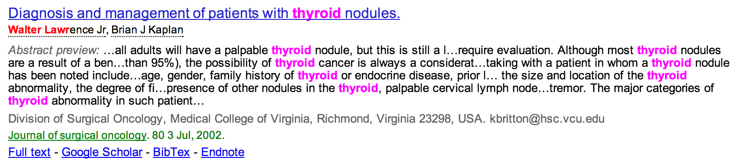
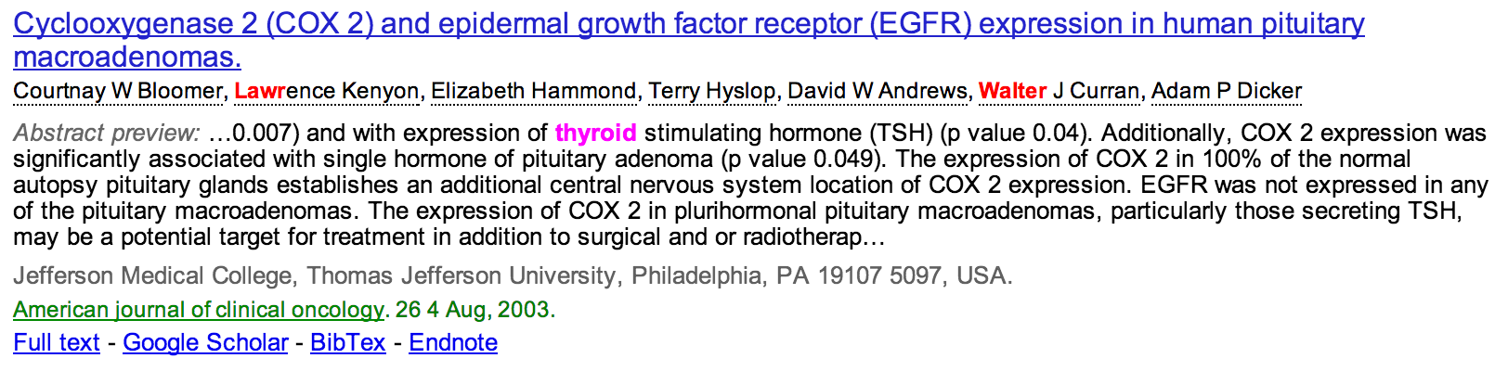
Looking for Walter Lawrence Jr’s publications on thyroid?
Fuzzy match
Prefix match
✔
✗

Slide 6

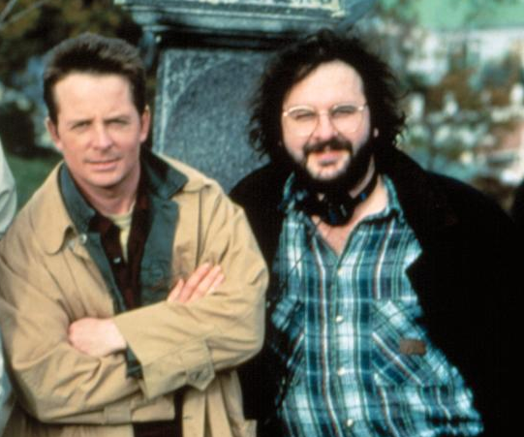
Proximity Ranking
Query = Michael Jackson
✔
OR
Michael Jackson
Michael J Fox
Peter Jackson
Queries typically contain correlated words

Slide 7
Challenges
Big Search Space
Query = cleam
Fuzzy Expansion
clean
clear
cream
cleanser
cleanliness
cleaner
cleanascite
…
clearance
cleary
clearomizer
cleardb
…
creamy
creamistry
creamer
creamola
…
Prefix Expansion
Computing all results may not be practical

Slide 8
Challenges
Early-Termination Guarantee
Query = new york
ID | Record | PageRank
r₁ | … New York … | 0.5
r₂ | … new students … York College … | 0.7
r₃ | … new year … | 0.8
… | … | …
new
york
…
r₃
…
r₂
…
r₁
…
r₂
…
r₁
r₁
r₁
termination
point
  Order does not guarantee good proximity ranking

Slide 9
Challenges
Index Size – Term-Pair Index*
Constructing term pairs within window size w=2
New York, New York, the city so nice they named it twice
New York, New York, the city so nice they named it twice
New York, New York, the city so nice they named it twice
New York, New York, the city so nice they named it twice
New York, New York, the city so nice they named it twice
New York, New York, the city so nice they named it twice
New York, New York, the city so nice they named it twice
New York, New York, the city so nice they named it twice
New York, New York, the city so nice they named it twice
New York, New York, the city so nice they named it twice
New York, New York, the city so nice they named it twice
New York, New York, the city so nice they named it twice
…
w=2
new york
new new
new the
york new
york york
york the
york city
the city
the so
…
-----------------------
w=2
  * Yan et al., CIKM 2010

Slide 10
Contributions
Adapted existing solutions
Space-efficient phrase-based indexing
Incremental method to identify indexed phrases
Methods for enumerating and ranking segmentations
Experimental study

Slide 11
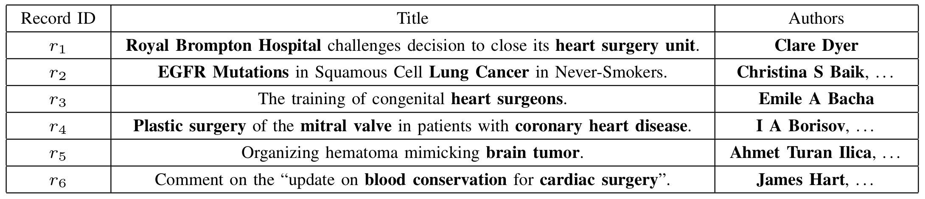
Phrase-Based Indexing
Phrase: a sequence of keywords likely to appear in the records and queries
    Person names
    Point of interests
    Popular n-grams
    …
Data dependent

Slide 12
Phrase-Based Indexing
Dictionary
  Distinct keywords
  Important phrases
Valid Phrase: Terms that appear in the dictionary

Slide 13
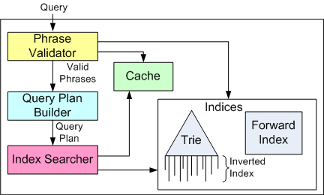
Life-cycle of a Query

Slide 14
Computing Valid Phrases
Query = <heart, surgery, unit>
Use trie for phrase validation
Incremental validation
  ANS(“heart”) ➔ ANS(“heart surgery” )
Pruning
  ANS(“heart”) = Ø ➔ ANS(“heart surgery”) = Ø

Slide 15
Incremental Computation
Typically subsequent queries differ by one character
q₁= <heart, surger>
q₂= <heart, surgery>
Valid Phrases:
heart
surger
heart surger
Valid Phrases:
heart
surgery
heart surgery
Phrases ending with last keyword of q₁ can be used to incrementally compute q₂
Group valid phrases based on end points

Slide 16
Incremental Approach
q₁ = < , >
heart
surge
•••
h
•••
v₁
(1, S_{1,1}= )
surge
unit
{n_{1,} n₂}
art
eart
n₁
n₂
n₃
n₇
surge
ry
n₄
n₅
ry
n₆
unit
n₈

Slide 17
Incremental Approach
q₁ = < >
heart, surge
•••
h
•••
v₁
{n₄}
(1, S_{1,2}= )
(1, S_{1,1}= )
surge
unit
{n_{1,} n₂}
art
eart
n₁
n₂
n₃
n₇
surge
ry
n₄
n₅
ry
n₆
unit
n₈

Slide 18
Incremental Approach
q₁ = < , >
heart
surge
•••
h
•••
v₁
{n₄}
(1, S_{1,2}= )
(1, S_{1,1}= )
surge
unit
{n_{1,} n₂}
{n₃}
art
eart
(2, S_{2,2}= )
n₁
n₂
n₃
n₇
surge
ry
n₄
n₅
ry
n₆
unit
n₈

Slide 19

Incremental Approach
q₂ = < , >
heart
surgery
•••
h
•••
Found
in
Cache
v₁
{n₄}
(1, S_{1,2}= )
(1, S_{1,1}= )
surge
unit
{n_{1,} n₂}
{n₃}
art
eart
(2, S_{2,2}= )
n₁
n₂
n₃
n₇
copy
surge
ry
v₂
n₄
n₅
(1, S_{1,1}= )
{n_{1,} n₂}
ry
n₆
unit
n₈

Slide 20
Incremental Approach
q₂ = < >
heart, surgery
•••
h
•••
v₁
{n₄}
(1, S_{1,2}= )
(1, S_{1,1}= )
surge
unit
{n_{1,} n₂}
{n₃}
art
eart
(2, S_{2,2}= )
n₁
n₂
n₃
n₇
copy
incremental
surge
ry
v₂
{n₆}
n₄
n₅
(1, S_{1,2}= )
(1, S_{1,1}= )
{n_{1,} n₂}
ry
n₆
unit
n₈

Slide 21
Incremental Approach
q₂ = < , >
heart
surgery
•••
h
•••
v₁
{n₄}
(1, S_{1,2}= )
(1, S_{1,1}= )
surge
unit
{n_{1,} n₂}
{n₃}
art
eart
(2, S_{2,2}= )
n₁
n₂
n₃
n₇
copy
incremental
surge
ry
v₂
{n₆}
n₄
n₅
(1, S_{1,2}= )
(1, S_{1,1}= )
{n_{1,} n₂}
{n₅}
(2, S_{2,2}= )
ry
n₆
unit
n₈

Slide 22
Incremental Approach
heart
surgery
q₃ = < , , >
heart
unit
•••
h
•••
v₁
{n₄}
(1, S_{1,2}= )
(1, S_{1,1}= )
surge
unit
{n_{1,} n₂}
{n₃}
art
eart
(2, S_{2,2}= )
n₁
n₂
n₃
n₇
copy
incremental
surge
ry
v₂
Found
in
Cache
{n₆}
n₄
n₅
(1, S_{1,2}= )
(1, S_{1,1}= )
{n_{1,} n₂}
{n₅}
(2, S_{2,2}= )
ry
n₆
copy
copy
unit
v₃
{n₆}
(1, S_{1,2}= )
(1, S_{1,1}= )
n₈
{n_{1,} n₂}
{n₅}
(2, S_{2,2}= )

Slide 23
Incremental Approach
heart, surgery, unit
q₃ = < >
•••
h
•••
v₁
{n₄}
(1, S_{1,2}= )
(1, S_{1,1}= )
surge
unit
{n_{1,} n₂}
{n₃}
art
eart
(2, S_{2,2}= )
n₁
n₂
n₃
n₇
copy
incremental
surge
ry
v₂
{n₆}
n₄
n₅
(1, S_{1,2}= )
(1, S_{1,1}= )
{n_{1,} n₂}
{n₅}
(2, S_{2,2}= )
ry
incremental
n₆
copy
copy
unit
v₃
{n₈}
{n₆}
(1, S_{1,3}= )
(1, S_{1,2}= )
(1, S_{1,1}= )
n₈
{n_{1,} n₂}
{n₅}
(2, S_{2,2}= )

Slide 24
Incremental Approach
surgery, unit
q₃ = < >
heart,
•••
h
•••
v₁
{n₄}
(1, S_{1,2}= )
(1, S_{1,1}= )
surge
unit
{n_{1,} n₂}
{n₃}
art
eart
(2, S_{2,2}= )
n₁
n₂
n₃
n₇
copy
incremental
surge
ry
v₂
{n₆}
n₄
n₅
(1, S_{1,2}= )
(1, S_{1,1}= )
{n_{1,} n₂}
{n₅}
(2, S_{2,2}= )
ry
incremental
n₆
copy
copy
unit
v₃
{n₈}
{n₆}
(1, S_{1,3}= )
(1, S_{1,2}= )
(1, S_{1,1}= )
n₈
{n_{1,} n₂}
{n₅}
(2, S_{2,2}= )
(1, S_{2,3}= )

Slide 25
Incremental Approach
heart
surgery
q₃ = < , , >
unit
•••
h
•••
v₁
{n₄}
(1, S_{1,2}= )
(1, S_{1,1}= )
surge
unit
{n_{1,} n₂}
{n₃}
art
eart
(2, S_{2,2}= )
n₁
n₂
n₃
n₇
copy
incremental
surge
ry
v₂
{n₆}
n₄
n₅
(1, S_{1,2}= )
(1, S_{1,1}= )
{n_{1,} n₂}
{n₅}
(2, S_{2,2}= )
ry
incremental
n₆
copy
copy
new
unit
v₃
{n₈}
{n₆}
(1, S_{1,3}= )
(1, S_{1,2}= )
(1, S_{1,1}= )
n₈
{n_{1,} n₂}
{n₇}
{n₅}
(3, S_{3,3}= )
(2, S_{2,2}= )

Slide 26
Enumerating Valid Segmentations
heart
surgery
q₃ = < , , >
unit
v₃
{n₈}
{n₆}
(1, S_{1,3}= )
(1, S_{1,2}= )
(1, S_{1,1}= )
{n_{1,} n₂}
{n₇}
{n₅}
(3, S_{3,3}= )
(2, S_{2,2}= )
SEG[n] = for each phrase (i, n) in V[n]:
SEG[i - 1] + (i, n)
    “heart surgery unit”
    “heart surgery” | “unit”
    “heart” | “surgery” | “unit”

Slide 27
Ranking Segmentations
    “heart surgery unit”
    “heart surgery” | “unit”
    “heart” | “surgery” | “unit”
Assumption: higher-ranked segmentations have more relevant results
Features for ranking
  Number of phrases
  Edit distance
  Frequency of phrases
  …
Executed in order

Slide 28
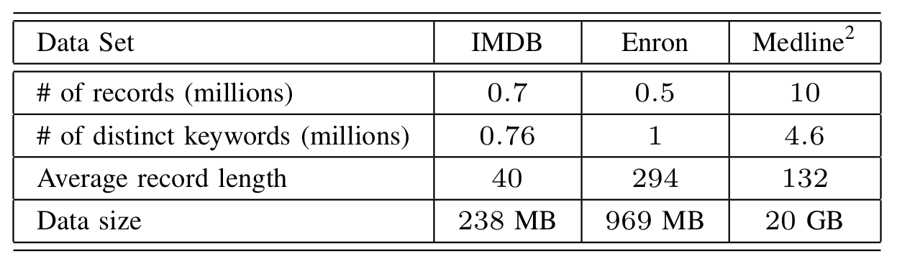
Experiments
One shard with 1.7 million records
Compared Techniques:
  Find All (FA)
  Term Pair (TP)
  Query Segmentation (QS)

Slide 29
Experiments
Index Size

Slide 30
Experiments
Valid-Phrase Computation

Slide 31
Experiments
Performance

Slide 32
Experiments
Scalability
FA
QS

Slide 33
Results
Term-Pair Index
  too much space
  too slow to be practical
FA
  better for long queries
  compact index
QS
  best for 2-keyword and 3-keyword queries
  good scalability
Hybrid of FA and QS works best.

Slide 34
Thanks!
Q&A

